Slide 1










G141105
Memory issues & Memory safety
Will Xin

Slide 2
G141105
Outline

Slide 3

G141105
Focus on one memory issue，memory leaks.
Causes
Effects
Solutions
(Problems)
Explain what memory
leaks are?
Analyze the impacts of
memory leaks.
Share feasible solutions,
including one optimal solution.
?

Slide 4
G141105
Causes

Slide 5
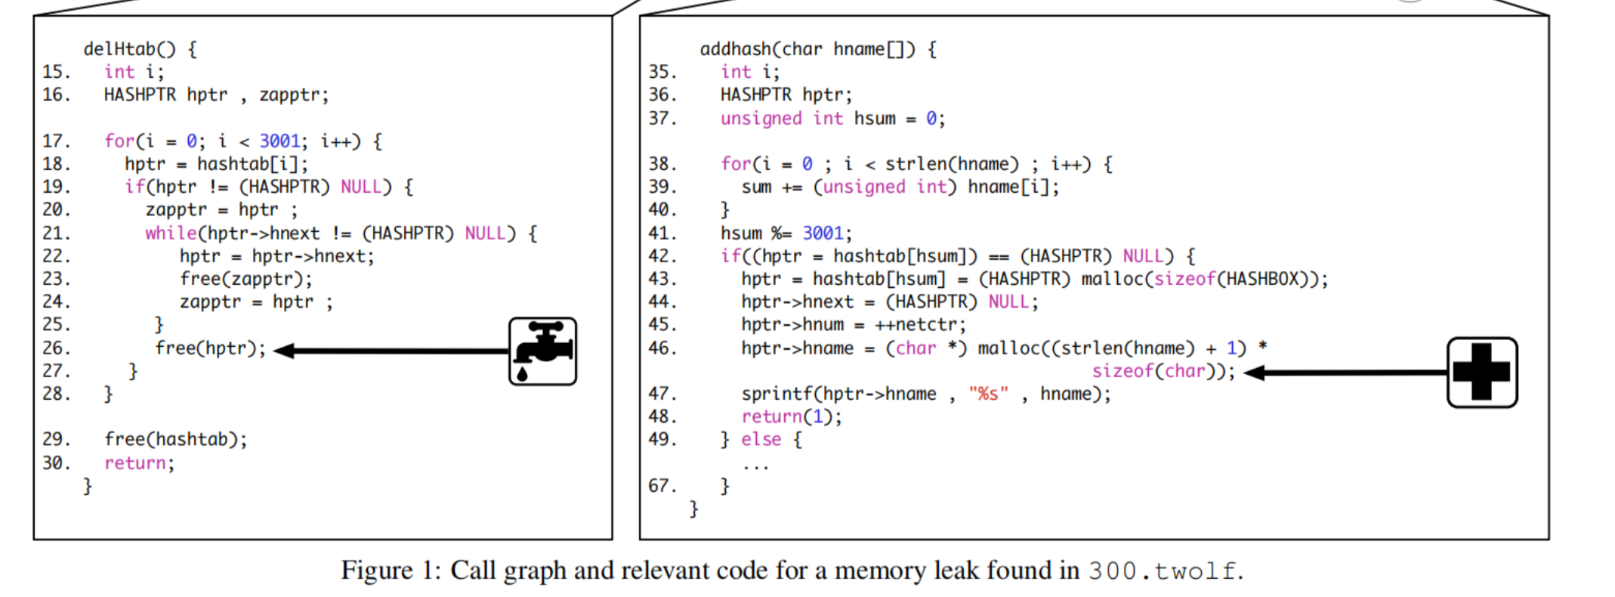
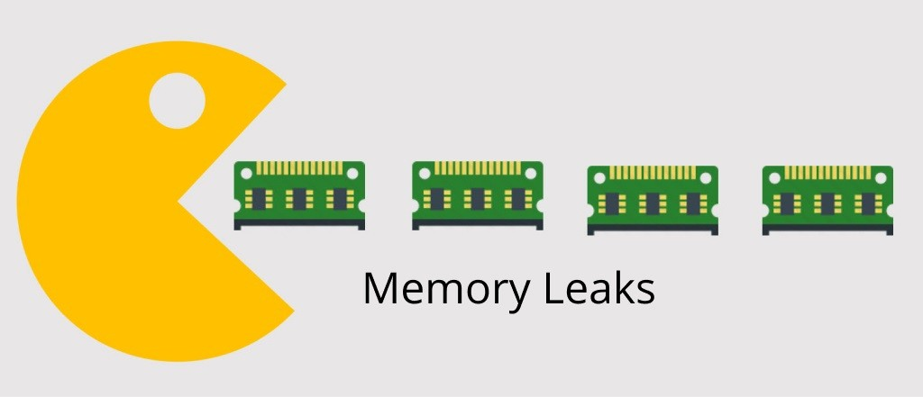
G141105
The cause of memory leaks
Source From: Clause, J & Orso, A 2010, ‘LEAKPOINT: pinpointing the causes of memory leaks’, in 2010 ACM/IEEE 32nd International Conference on Software Engineering, ACM, New York, NY, USA, pp. 515–524.

Slide 6
G141105
Effects

Slide 7
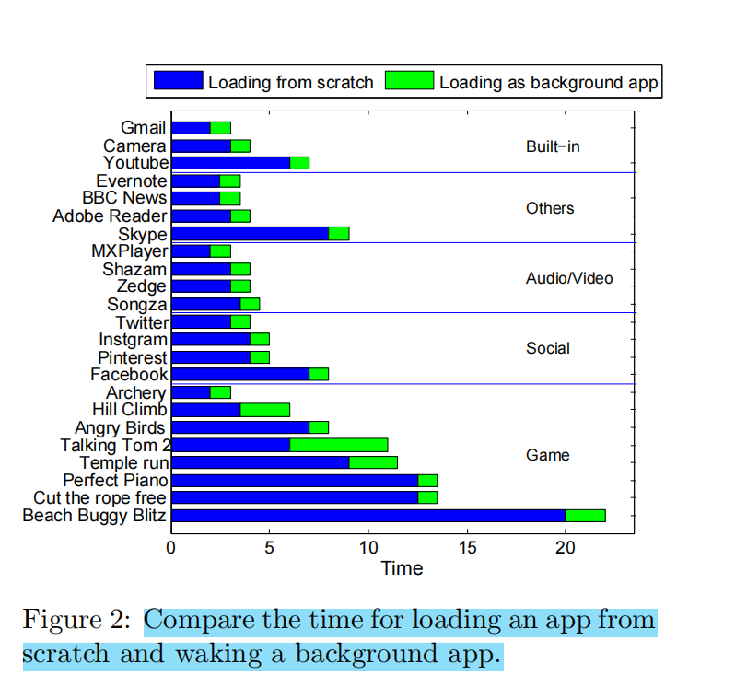
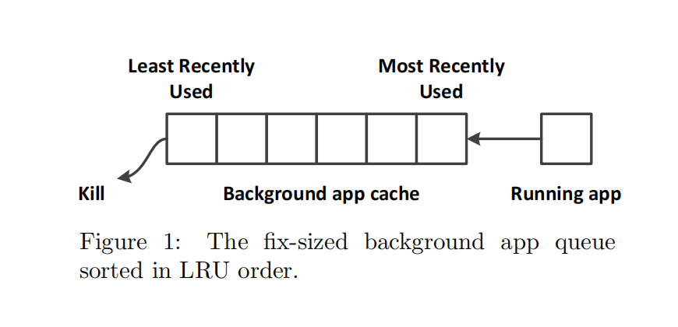
G141105
One problem resulting from memory leaks
Source From: Xia, M, He, W, Liu, X & Liu, J 2013, ‘Why application errors drain battery easily?: a study of memory leaks in smartphone apps’, in Proceedings of the Workshop on Power-Aware Computing and Systems, ACM, New York, NY, USA, pp. 1–5.

Slide 8
G141105
ProblemAnalysis

Slide 9
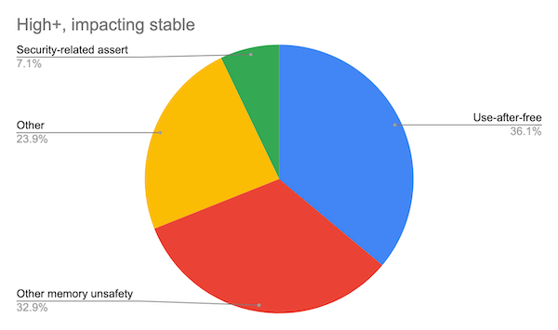
G141105
Which problem should be given top priority?
👉🏻 Around 70% of high-severity security bugs are memory unsafety
problems (that is, mistakes with
C/C++ pointers).
Half of those are use-after-free bug.
Source From: The Chromium Project, 'Analysis based on 912 high or critical severity security bugs since 2015, affecting the Stable channel', accessed July 2024 < https://www.chromium.org/Home/chromium-security/memory-safety/ >
Notes:
Before the solutions, let’s analyze a bugs report to determin which problem should be given top priority?
This pie chart was source from the Chromiunm Project, according to this pie chart, the percentage of ....,
According to this pie chart, the percentage of use-after-free issues occupies the largest share, at about 36%, followed by other memory unsafety issues at 32.9%.
One interesting detail here is that around three quarters (70%) of high-severity security bugs are related to memory unsafety problems.
So.. we need to find solutions to address these probelms.

Slide 10
G141105
Solutions

Slide 11
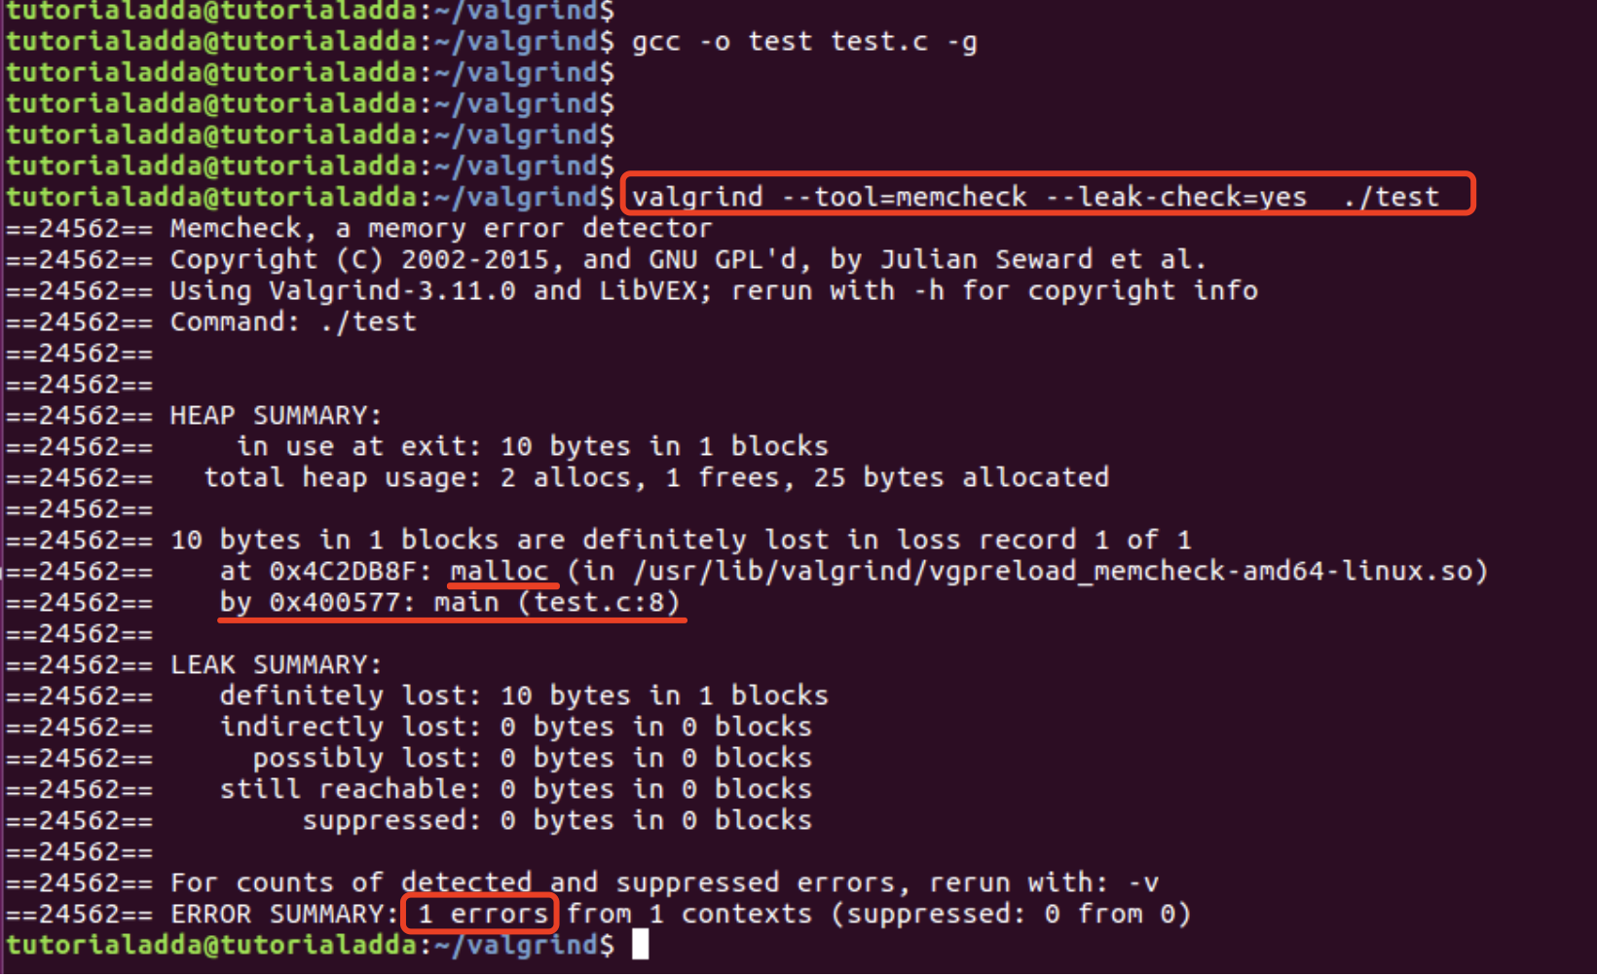
G141105
Solution 1: Memory Leak Detection Tools
Memory Leak Detection Tools, such as
Valgrind and AddressSanitizer
Pros:
Guide developers to troubleshot memory issues.
Locate the codes with potential memory issues.
Cons:
The accuracy depends on the tools.
Some mistakes may be missed.
Notes:
First, we can use memory leak detection tools. These tools can help developers us to locate the incorrect codes and troubleshoot tricky issues.

Slide 12


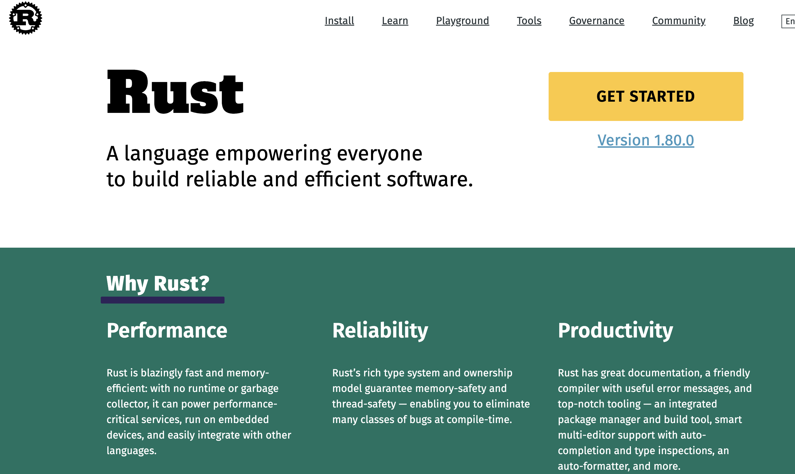


G141105
Solution 2 (Recommended): Use a modern language, Rust
Notes:
The recommended solution to avoid memory issues is using a new programming language, Rust.
The mascot of Rust is a crab; it's very cute.
Rust was created by a software engineer from Mozilla, the company behind Firefox.
This language incorporates many advantages from other programming languages.
The essential feature of this language is its borrow and ownership model, which ensures your code will not have memory safety issues, making your programs more efficient and robust.

Slide 13
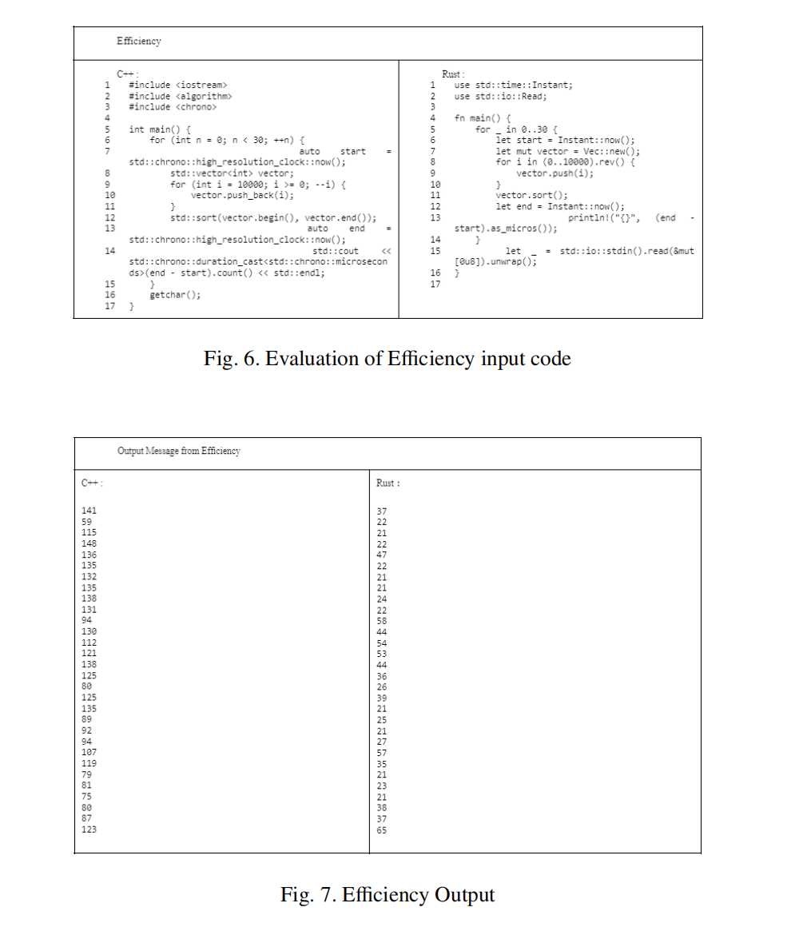
G141105
Rust is efficient
Source From: Oey, KAS, Kwee, C, Chua, W, Nabiilah, GZ & Rojali 2023, ‘Rust’s Memory Safety Model: An Evaluation of Its Effectiveness in Preventing Common Vulnerabilities’, Procedia Computer Science, vol. 227, pp. 119–127.
Notes:
Why should we use Rust? The first reason is that Rust is efficient.
This is supported by Oey et al. (2023), they suggest that compared with CPP, Rust is more efficient with the same logic and algoriths.This is because Rust has lower time cost, both in average time cost and minimal time cost.

Slide 14
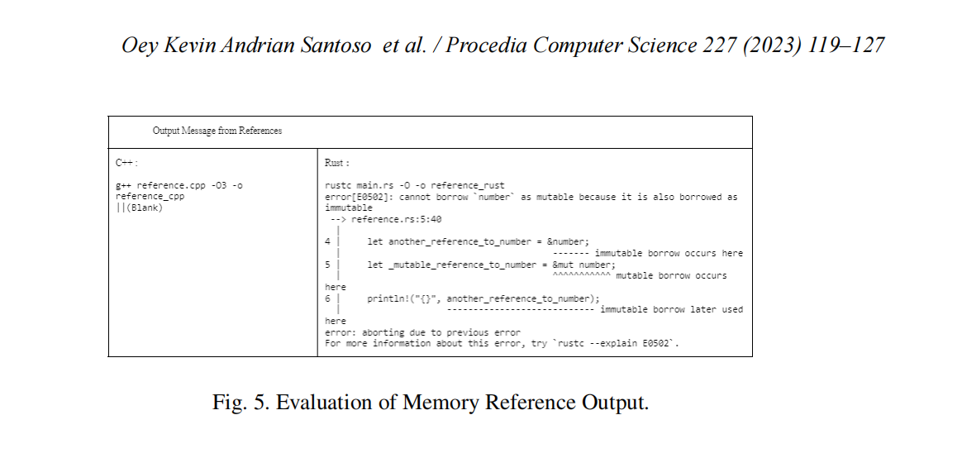
G141105
Rust is friendly
Source From: Oey, KAS, Kwee, C, Chua, W, Nabiilah, GZ & Rojali 2023, ‘Rust’s Memory Safety Model: An Evaluation of Its Effectiveness in Preventing Common Vulnerabilities’, Procedia Computer Science, vol. 227, pp. 119–127.
Notes:
Another figure from the same research proves that rust is friendly, because the compiler of Rust provides more detailed tips for developers.As can be seen for Figure 5, it shows a wavy line under the incorrect code.

Slide 15
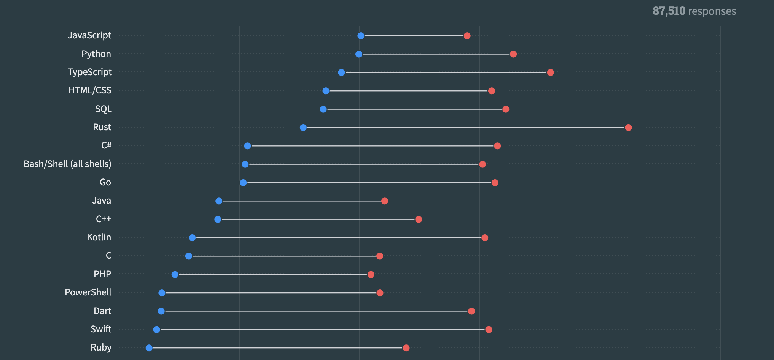
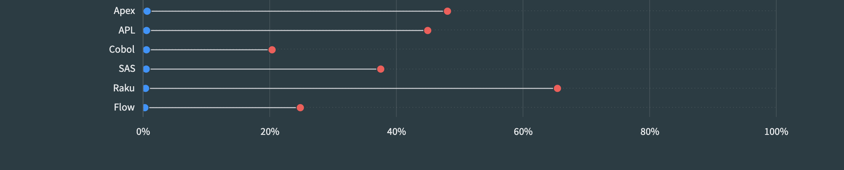
G141105
Rust is popular
Source From: Stackoverflow 2023, 'Stack Overflow Developer Survey', accessed 20 July 2024, <https://survey.stackoverflow.co/2023/#section-admired-and-desired-programming-scripting-and-markup-languages>
Notes:
Look at this statistics, data from Stack Overflow, a programming forum, show that Rust is the most admired language,
with more than 80% of developers wanting to use it again next year.

Slide 16

G141105
Rust is ....
Source From: Stackoverflow 2023, 'Stack Overflow Developer Survey', accessed 20 July 2024, <https://survey.stackoverflow.co/2023/#section-admired-and-desired-programming-scripting-and-markup-languages>
Notes:
However, like a coin with two sides, Rust also has some drawbacks.
The grammar of this language can be very complicated compared to Java and Python, which means developers must invest significant time and energy to master it.

Slide 17
G141105
Conclsion

Slide 18
G141105
Reference List (Harvard Reference)
Clause, J & Orso, A 2010, ‘LEAKPOINT: pinpointing the causes of memory leaks’, in 2010 ACM/IEEE 32nd International Conference on Software Engineering, ACM, New York, NY, USA, pp. 515–524.
Oey, KAS, Kwee, C, Chua, W, Nabiilah, GZ & Rojali 2023, ‘Rust’s Memory Safety Model: An Evaluation of Its Effectiveness in Preventing Common Vulnerabilities’, Procedia Computer Science, vol. 227, pp. 119–127.
Xia, M, He, W, Liu, X & Liu, J 2013, ‘Why application errors drain battery easily?: a study of memory leaks in smartphone apps’, in Proceedings of the Workshop on Power-Aware Computing and Systems, ACM, New York, NY, USA, pp. 1–5.

Slide 19
G141105
Q&A

Slide 20
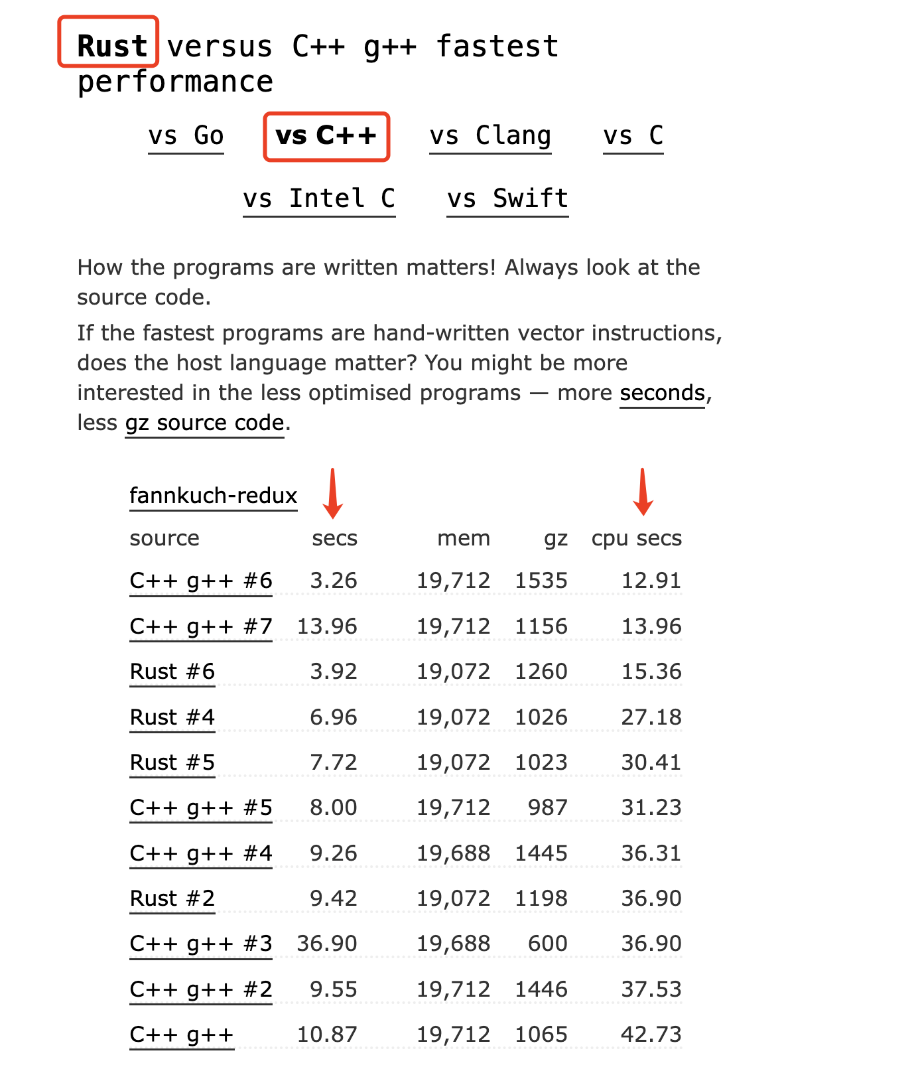
G141105
Reflection: Is Rust faster than C++ in all situations?
Source From: Benchmarksgame-team, 'Rust versus C++ g++ fastest performance', accessed 20 July 2024, <https://benchmarksgame-team.pages.debian.net/benchmarksgame/fastest/rust-gpp.html>
Notes:
Based on the research I mentioned just now, is Rust more efficient than C++ in all situations?
I searched this information on the Internet, and I found that the running speed of programs depends on mnay factors. such as the compiler version and specific use cases.
Therefore, we cannot definitively say Rust is faster than C++ under all conditions.
By asking questions ouselves, I think it’s a good way to foster critical thinking.

Slide 21
G141105
Q&A

Slide 22
G141105
Thanks

